Slide 1
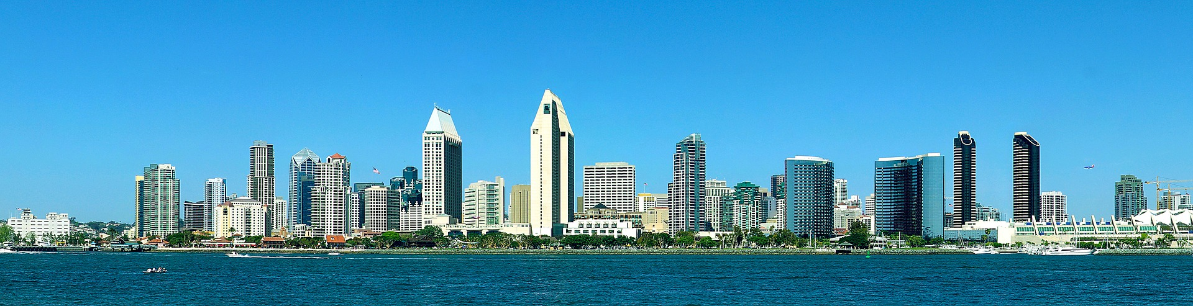
WhereSIOUS - San Diego
Where Should I Open Up Shop?
Jeffrey Silverman

Slide 2
WhereSIOUS - San Diego
Where Should I Open Up Shop?
Jeffrey Silverman
Should my new restaurant go here?
Is this a good place for my next car dealership?
Notes:
The City of San Diego wants to use *data* to improve things.
Specifically, using information about different neighborhoods in SD and how well businesses have done there in the past, I can predict the place where businesses will be most successful.
SHOW DEMO: SD Convention Center, code=44 (car dealership), then all of SD map

Slide 3
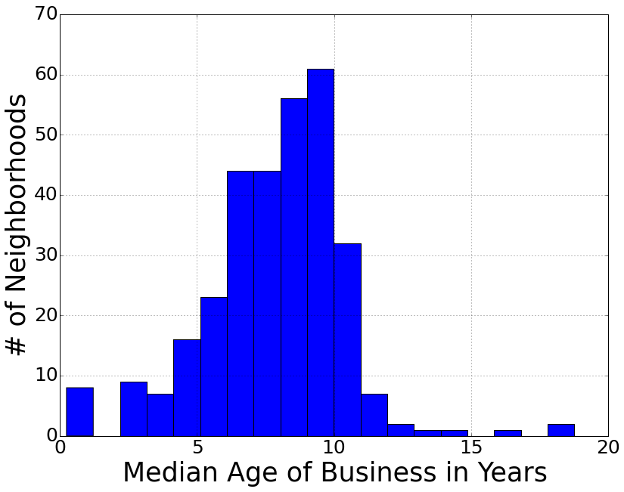
Longevity == Business Success
typical business age ≈ 8 years
56,710 businesses in 313 neighborhoods
Notes:
After discussions with SD officials, including people in the Data Office and the Business Development Office, we decided, given the dataset, that a good measure of a business’ success is how long it’s been around.
So I took the list of all current businesses in SD and calculated the median age of all businesses in each neighborhood (census tract).

Slide 4


From Data to WhereSIOUS Score
business age & location, type of business
describe each neighborhood & their businesses

Slide 5


From Data to WhereSIOUS Score
business age & location, type of business
population, housing, income, & employment data; walk/bike/transit scores
describe each neighborhood & their businesses

Slide 6


From Data to WhereSIOUS Score
business age & location, type of business
population, housing, income, & employment data; walk/bike/transit scores
describe each neighborhood & their businesses
linear regression with input data & business ages

Slide 7
From Data to WhereSIOUS Score
business age & location, type of business
population, housing, income, & employment data; walk/bike/transit scores
describe each neighborhood & their businesses
linear regression with input data & business ages
calculate WhereSIOUS score (scaled from predicted business age) for each neighborhood

Slide 8
From Data to WhereSIOUS Score
business age & location, type of business
population, housing, income, & employment data; walk/bike/transit scores
describe each neighborhood & their businesses
user enters a business type (& optional address)
linear regression with input data & business ages
calculate WhereSIOUS score (scaled from predicted business age) for each neighborhood

Slide 9

From Data to WhereSIOUS Score
output WhereSIOUS score(s) & Google Map to website!
business age & location, type of business
population, housing, income, & employment data; walk/bike/transit scores
describe each neighborhood & their businesses
user enters a business type (& optional address)
linear regression with input data & business ages
calculate WhereSIOUS score (scaled from predicted business age) for each neighborhood

Slide 10
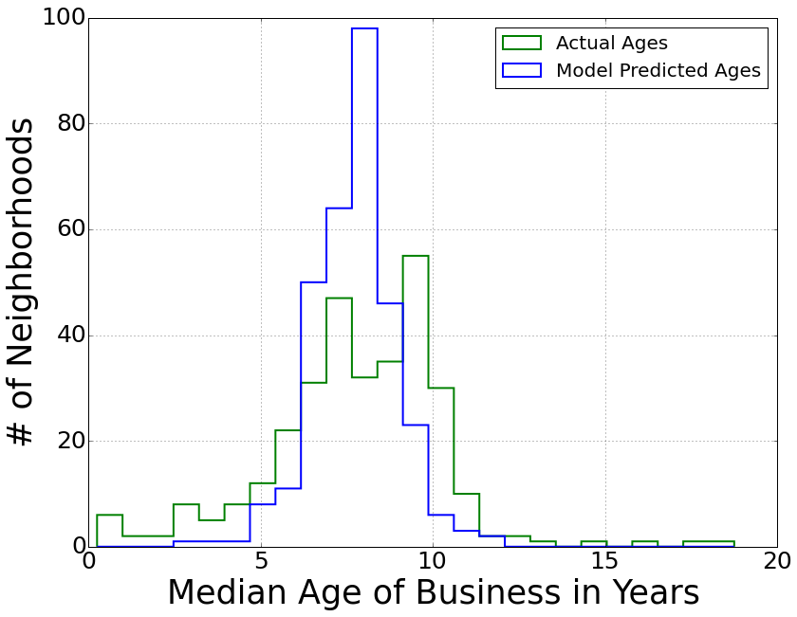
Validation (LOOCV = 0.105; r² = 0.23)
Model “corrects” outlier neighborhoods
Notes:
My predicted range of ages is narrower than the input, which is good since the neighborhoods with really high and really low median all have very few businesses in them (i.e., small number stats) so they aren’t very trustworthy for the model.
10x better than just using # of businesses in each neighborhood
2x better than using # of businesses, but cutting some of the most extreme outliers
BIC = -203; 41 features used

Slide 11
Downtown San Diego
Notes:
Along the waterfront is not great for business, possibly a high rate of turnover.
Gaslamp and the Balboa Park area are pretty good for businesses, and this area just north of downtown, between 2 major freeways is really good.

Slide 12
SD State University & Qualcomm Stadium
Notes:
Here’s SDSU and mostly residential areas just east of it, which aren’t great for businesses since there tends to be lots of turnover near universities.
Whereas, along the 8, 15, and 805, and near Qualcomm Stadium are pretty good neighborhoods for businesses.

Slide 13


Successful Businesses Tend to Have…
Higher median age
Higher employment percentage
Notes:
0.2724 +/- 0.078 (3.5 sigma)
0.1188 +/- 0.075 (1.5 sigma)

Slide 14


Successful Businesses Tend to Have…
Higher median age
Higher employment percentage
…and possibly have…
Higher percent female population
Higher percent adult population
Notes:
0.1722 +/- 0.116 (1.5 sigma)
0.1598 +/- 0.119 (1.3 sigma)

Slide 15


Successful Businesses Tend to Have…
Higher median age
Higher employment percentage
…and possibly have…
Higher percent female population
Higher percent adult population
Higher “walk score”
Lower “bike score” (?!)
X
Notes:
Walk score is calculated based on walking distance to businesses and pedestrian friendliness (e.g., block length and intersection density, but NOT hilliness).
Bike score is based on number of bike lanes, hilliness of an area, road connectivity, and the number of bike commuters. So with some hills and not many bike commuters, bike scores are relatively low in much of SD and *might* be lower near more successful businesses.
(Transit score indicates how well a location is served by public transit based on the distance to and frequency and mode of transportation of nearby transit routes.)
1 sigma, 1.5 sigma

Slide 16


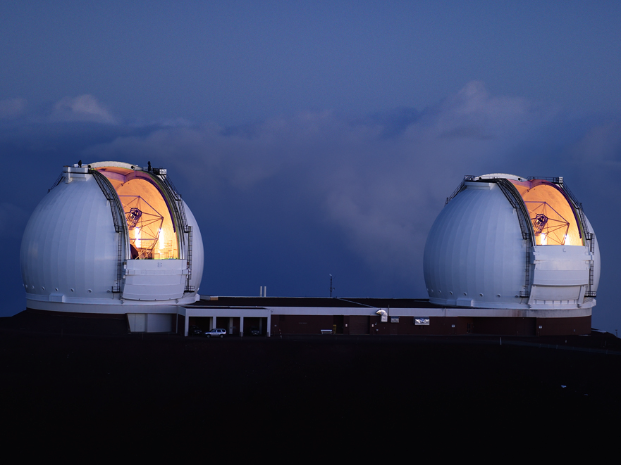


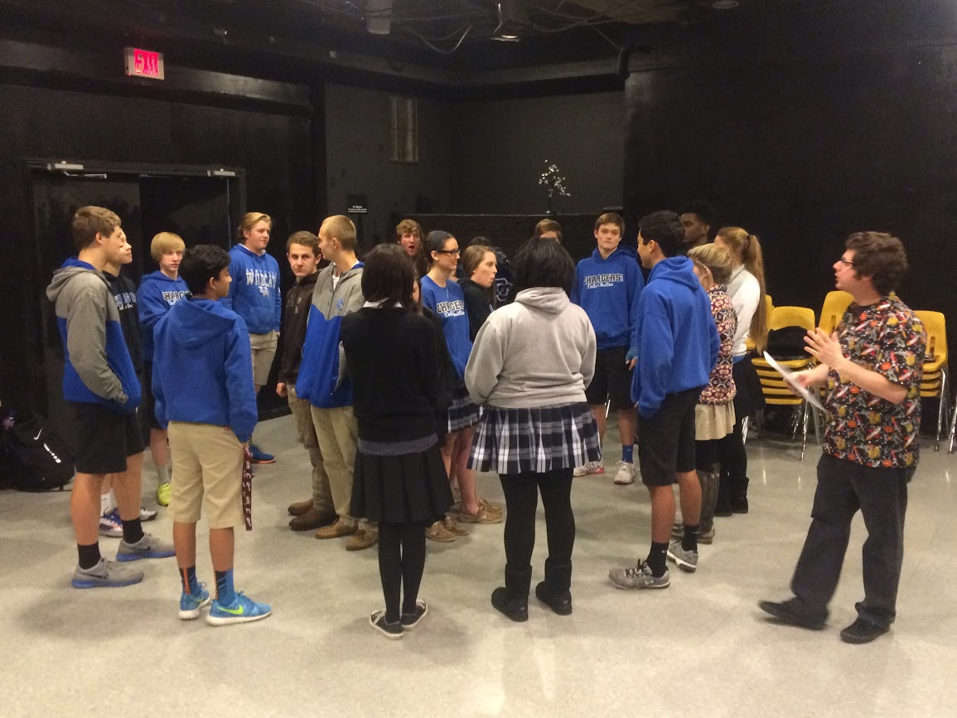
Jeffrey Silverman

Slide 18
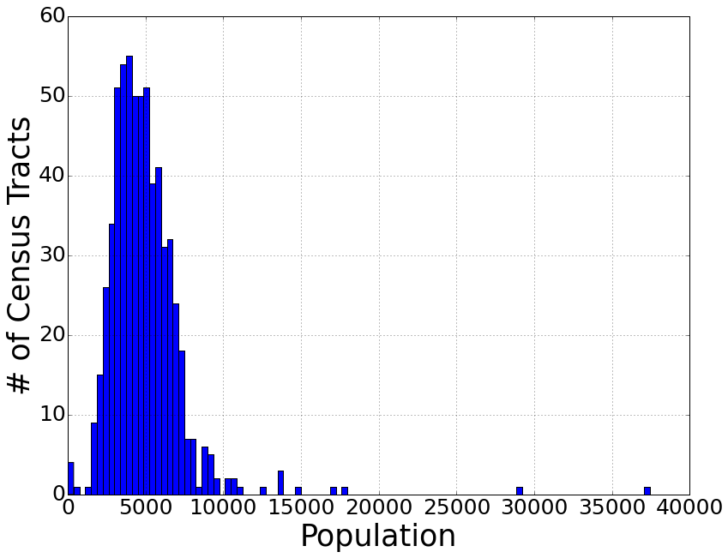
Neighborhoods (i.e., Census Tracts)
average population
per census tract ≈ 4930
Notes:
Census tracts are subdivisions used by the US Census.
There are supposed to be about 5000 people in each census tract, which seems to be true for the city of SD.
Of course this means that there’s a wide range in the physical sizes of different census tracts with very sparsely populated tracts being physically much larger.
This is the resolution of my model, in other words, I predict how successful a business will be in a given census tract.

Slide 19
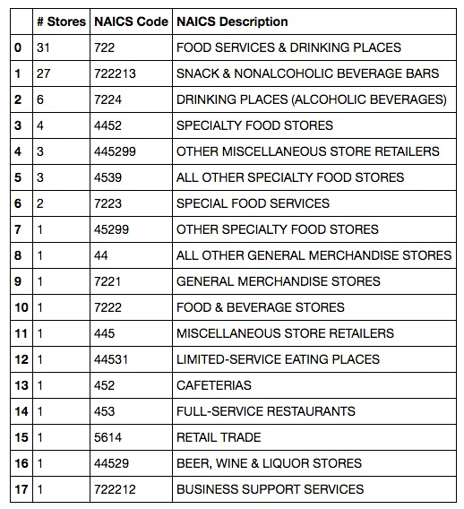

Business Info – NAICS (North American Industry Classification System)
Notes:
NAICS has a bunch of numeric codes to describe various industries, so hopefully I can use this to identify different business types and how they perform in different locations.
Each business has a single code, but they’re not super unique and very similar businesses have different codes!
For example, Starbucks has 87 locations in SD with 18 different NAICS codes!
Their numbering system has the first two-digits as the most general category and then more digits refine the classification (i.e., 722, 7224, 722213).
I could just use the codes as-is, but it seems silly that we have 18 different “types” of Starbucks.
So I took the first two digits, which are the top-most level in the classification hierarchy.

Slide 20
Business Info – NAICS (North American Industry Classification System)
4 “simple” codes
79% are Code 72
13% are Code 44
Notes:
This method turns this list into 4 different codes for all Starbucks, with 79% of them sharing the same code (72), 13% with a second code (44)

Slide 21
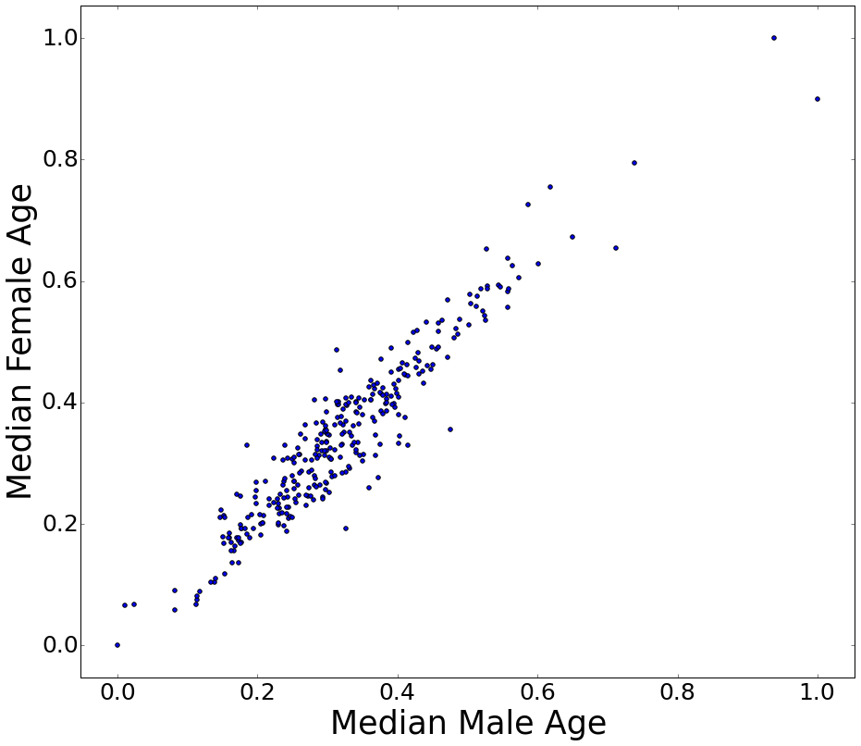
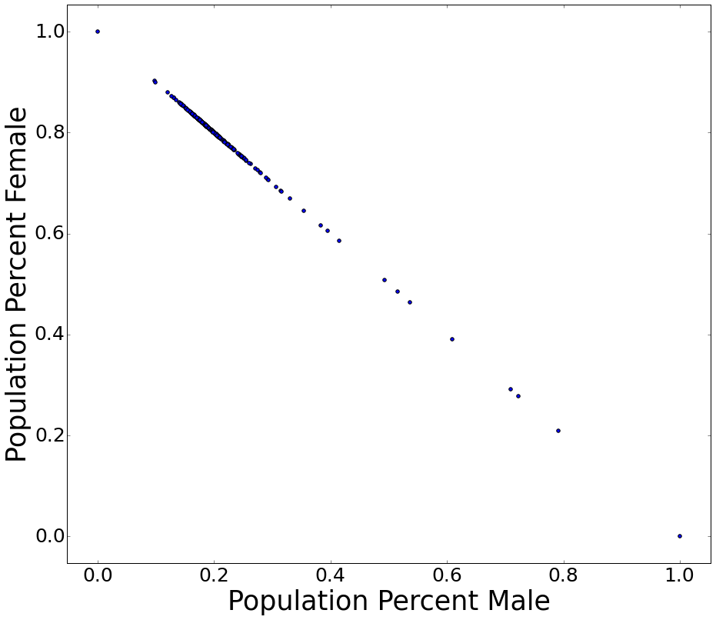
Fun With Census Data!

Slide 22
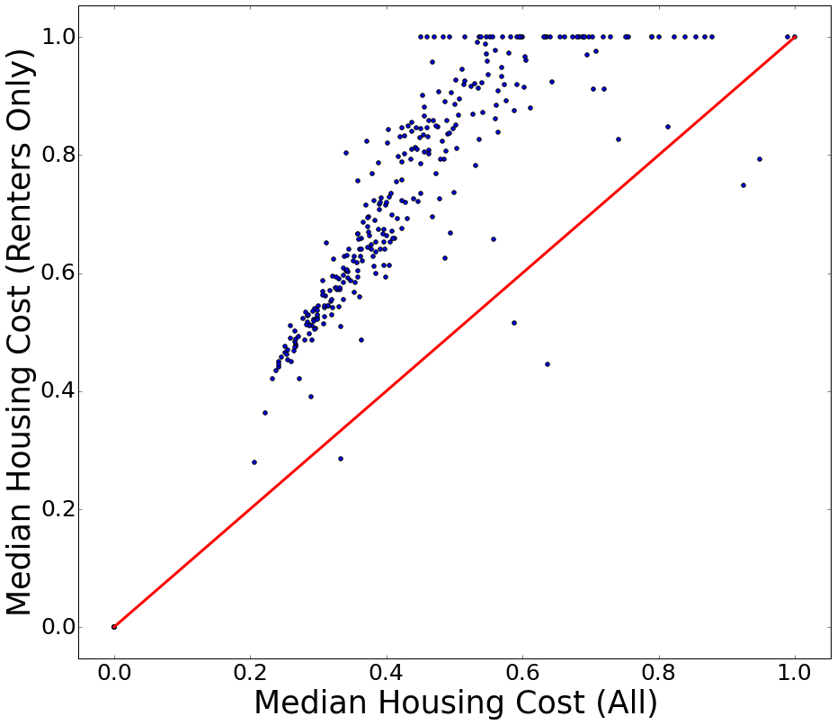
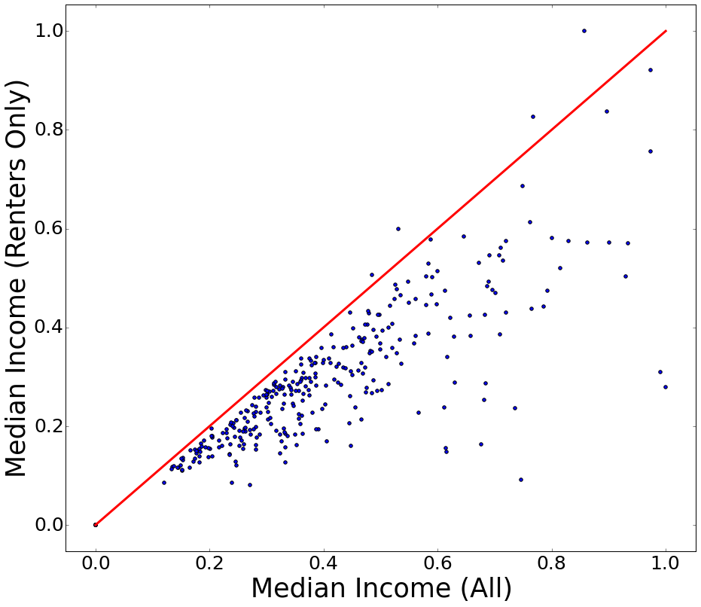
Fun With Census Data!

Slide 23
Features Used (41)
Total # of businesses
Total # of businesses of each type
Total population
Percent female population (1.5σ)
Percent adult population (1.3σ)
Median age (3.5σ)
Total # of homes
Employment percentage (1.5σ)
Median income
Median income for homeowners
Median income for renters
Median housing cost
Median housing cost for homeowners
Median housing cost for renters
Walk score (1σ)
Transit score
Bike score (1.5σ)
Total annual amount spent in parking meters
Notes:
0.2724 +/- 0.078 (3.5 sigma)
0.1188 +/- 0.075 (1.5 sigma)
0.1722 +/- 0.116 (1.5 sigma)
0.1598 +/- 0.119 (1.3 sigma)

